Slide 1
BVR Drawdown effects
WVWA Report August 2022

Slide 2
Figures TO DO
Schmidt from sonde
Remake thermos depth and buoyancy freq from sonde
Tie in YSI data for CTD heatmaps
Figure out chl-a
Figure with both emissions and concentrations
Calculate emissions from surface samples for comparison

Slide 3
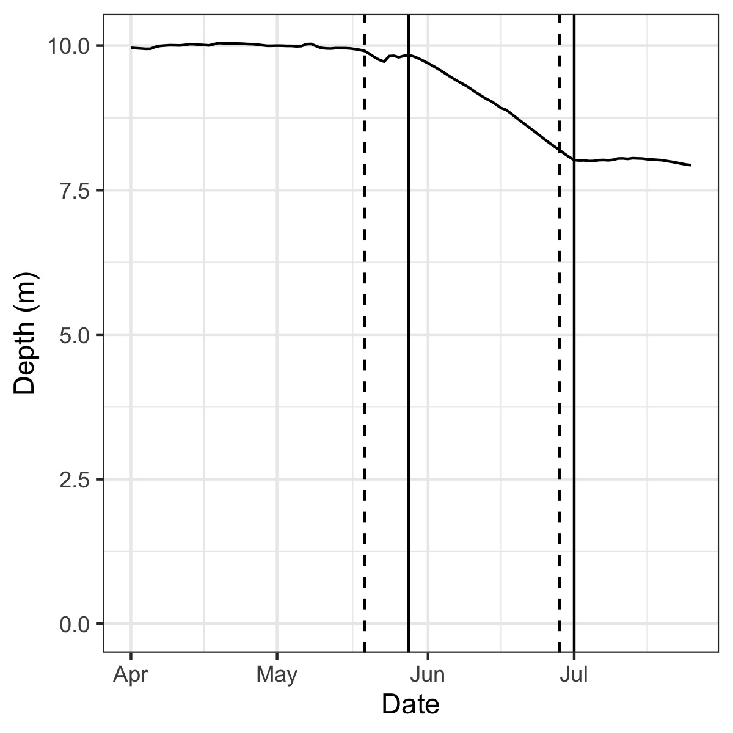
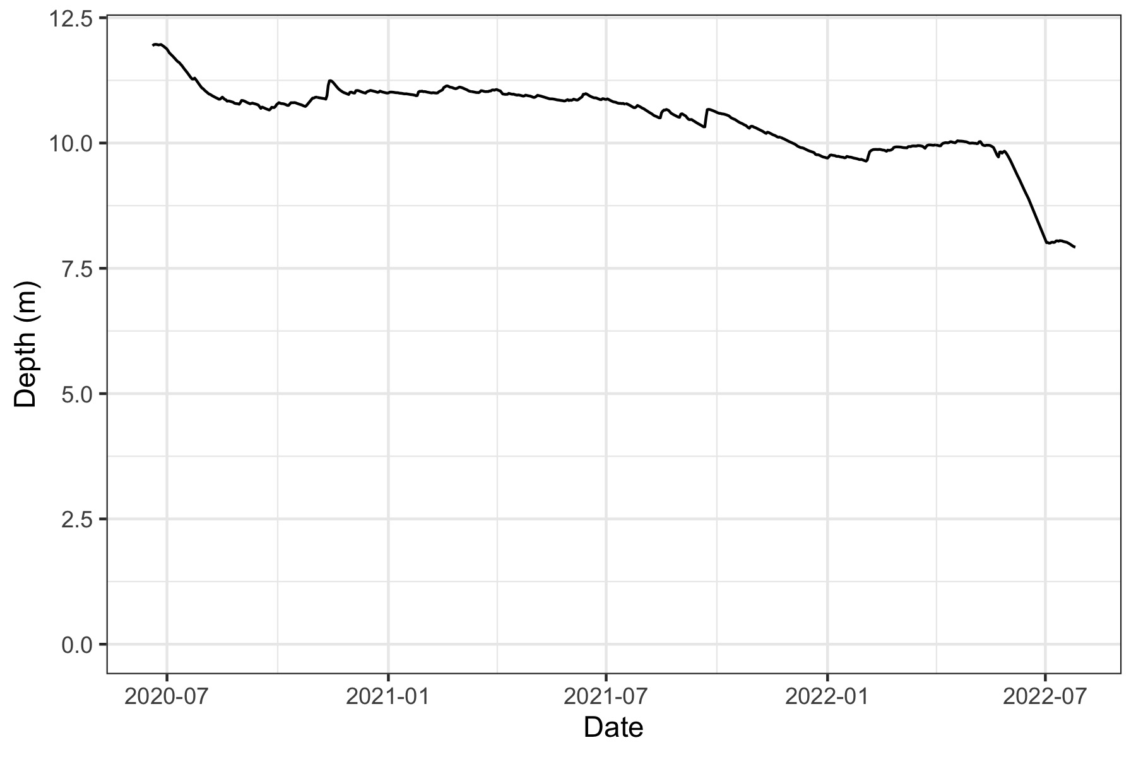
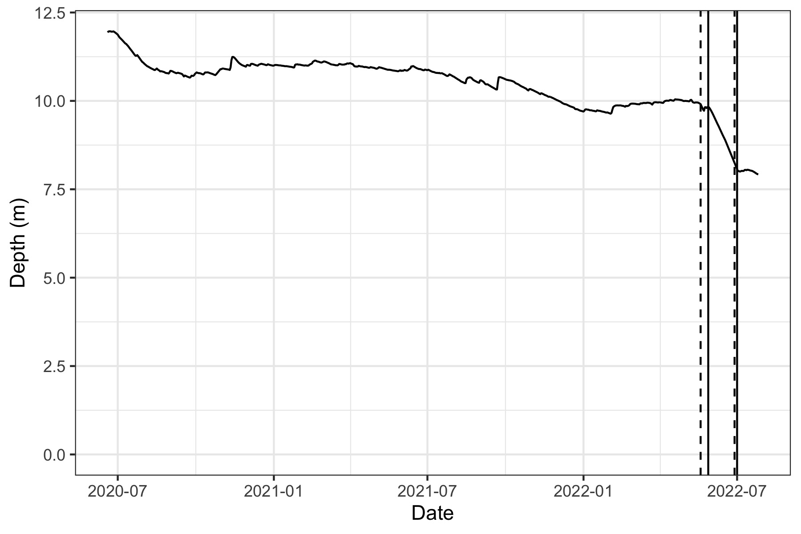
BVR water level

Slide 4
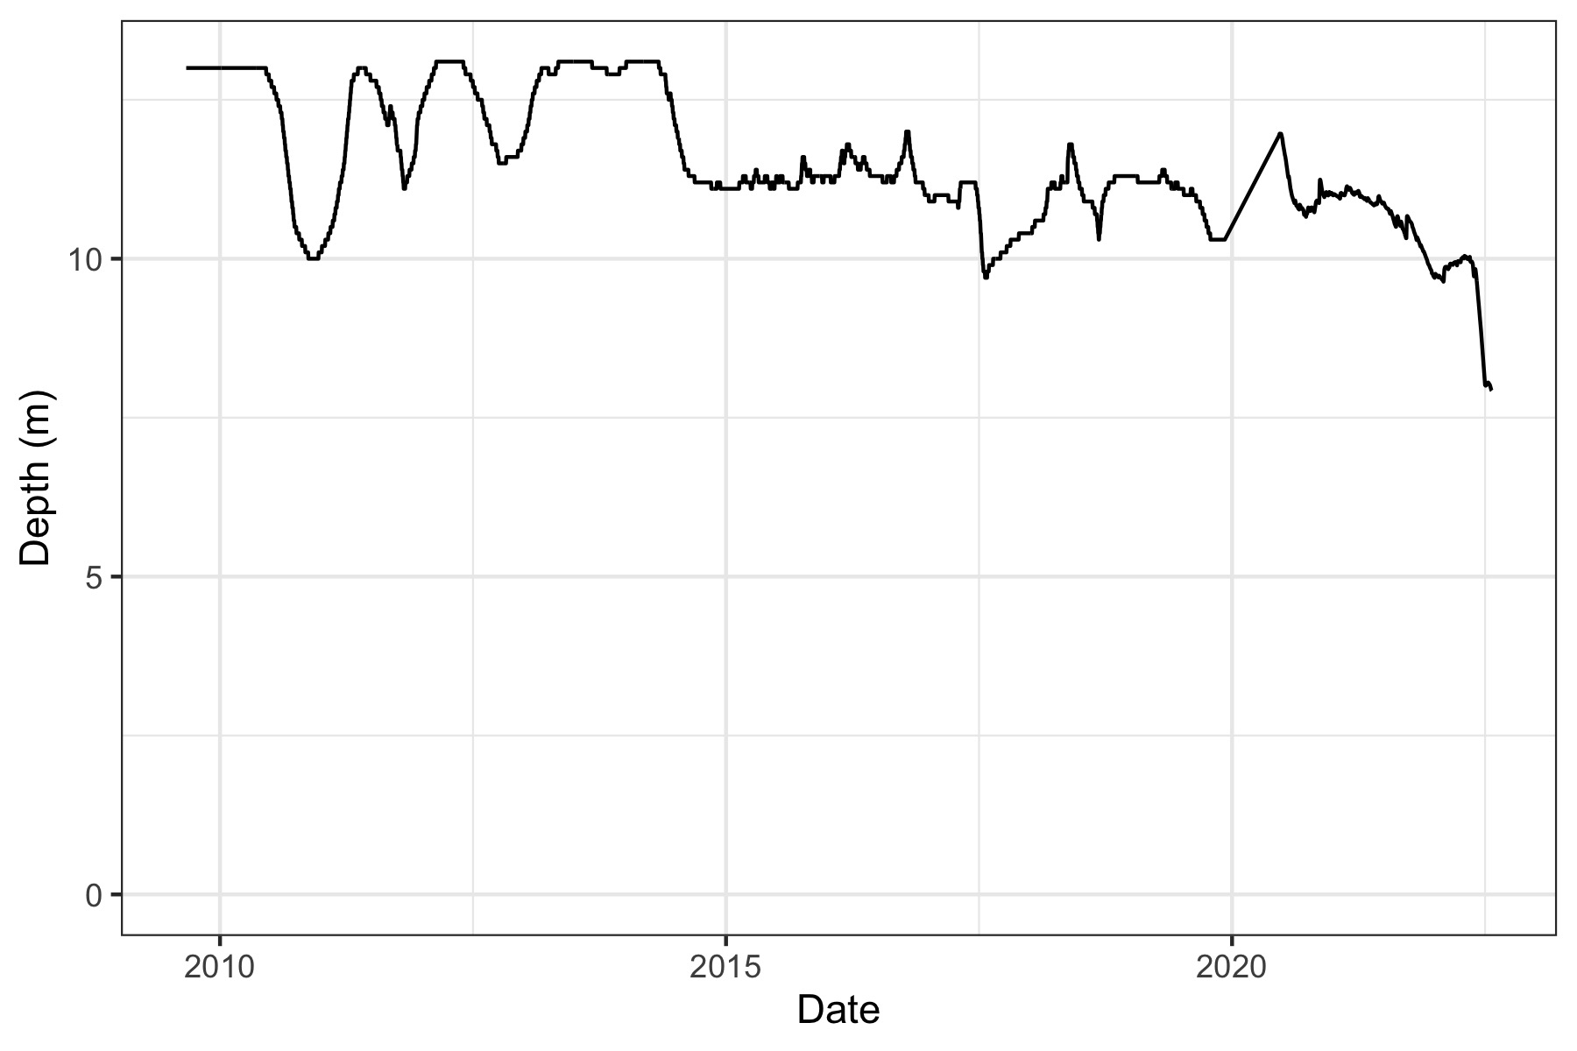
Looking back to 2013

Slide 5
Physical changes
Schmidt
Make with sonde data
Thermo depth
Make without 2020
Bouyancy freq
Make without 2020

Slide 6
Chemical changes
Turbidity
DO
Stat: m of oxic habitat and TDO3 (temp at which DO<3)
pH
Compare to 2021 (using handheld probe)
fDOM
Metals
Compare to 2021
Nutrients?

Slide 7
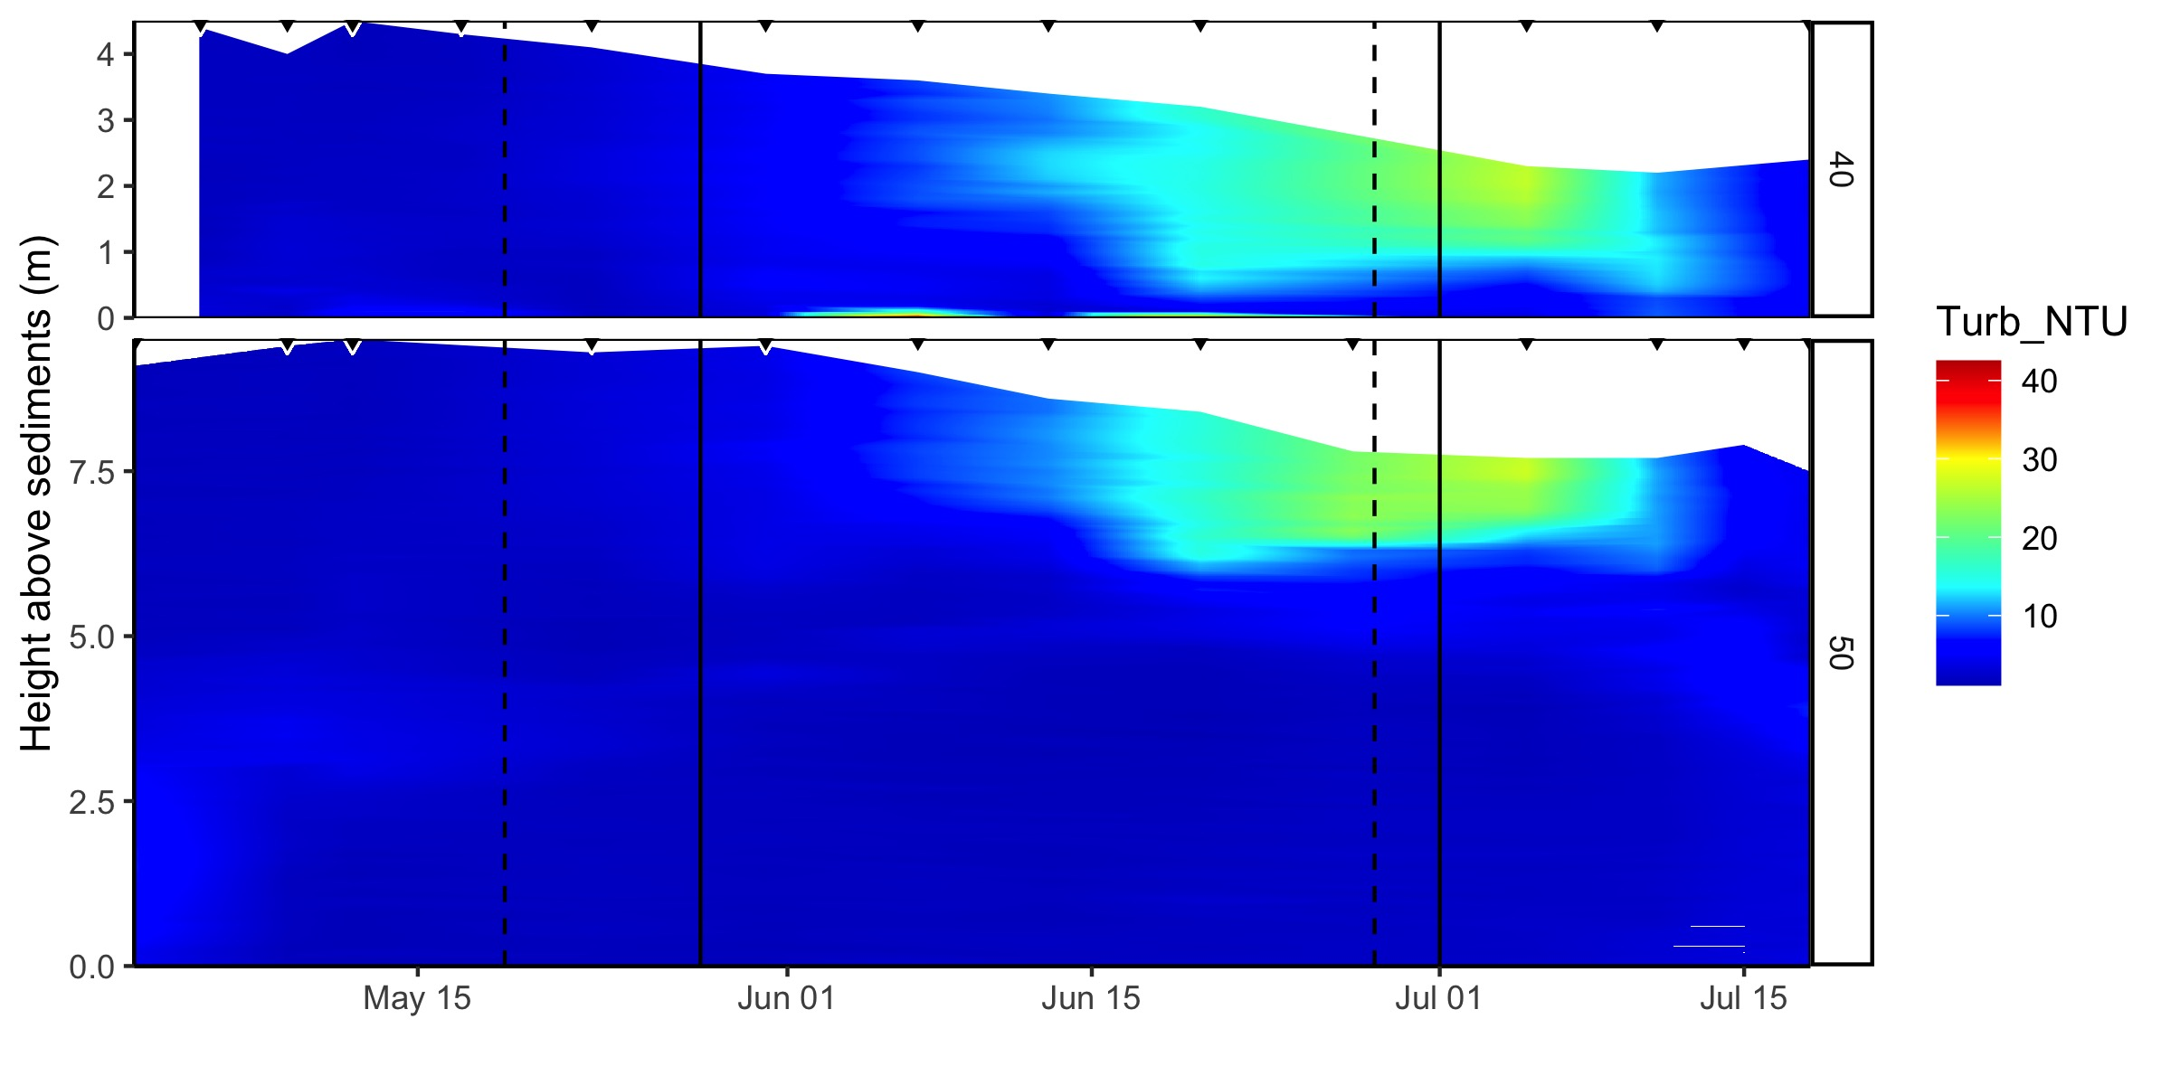
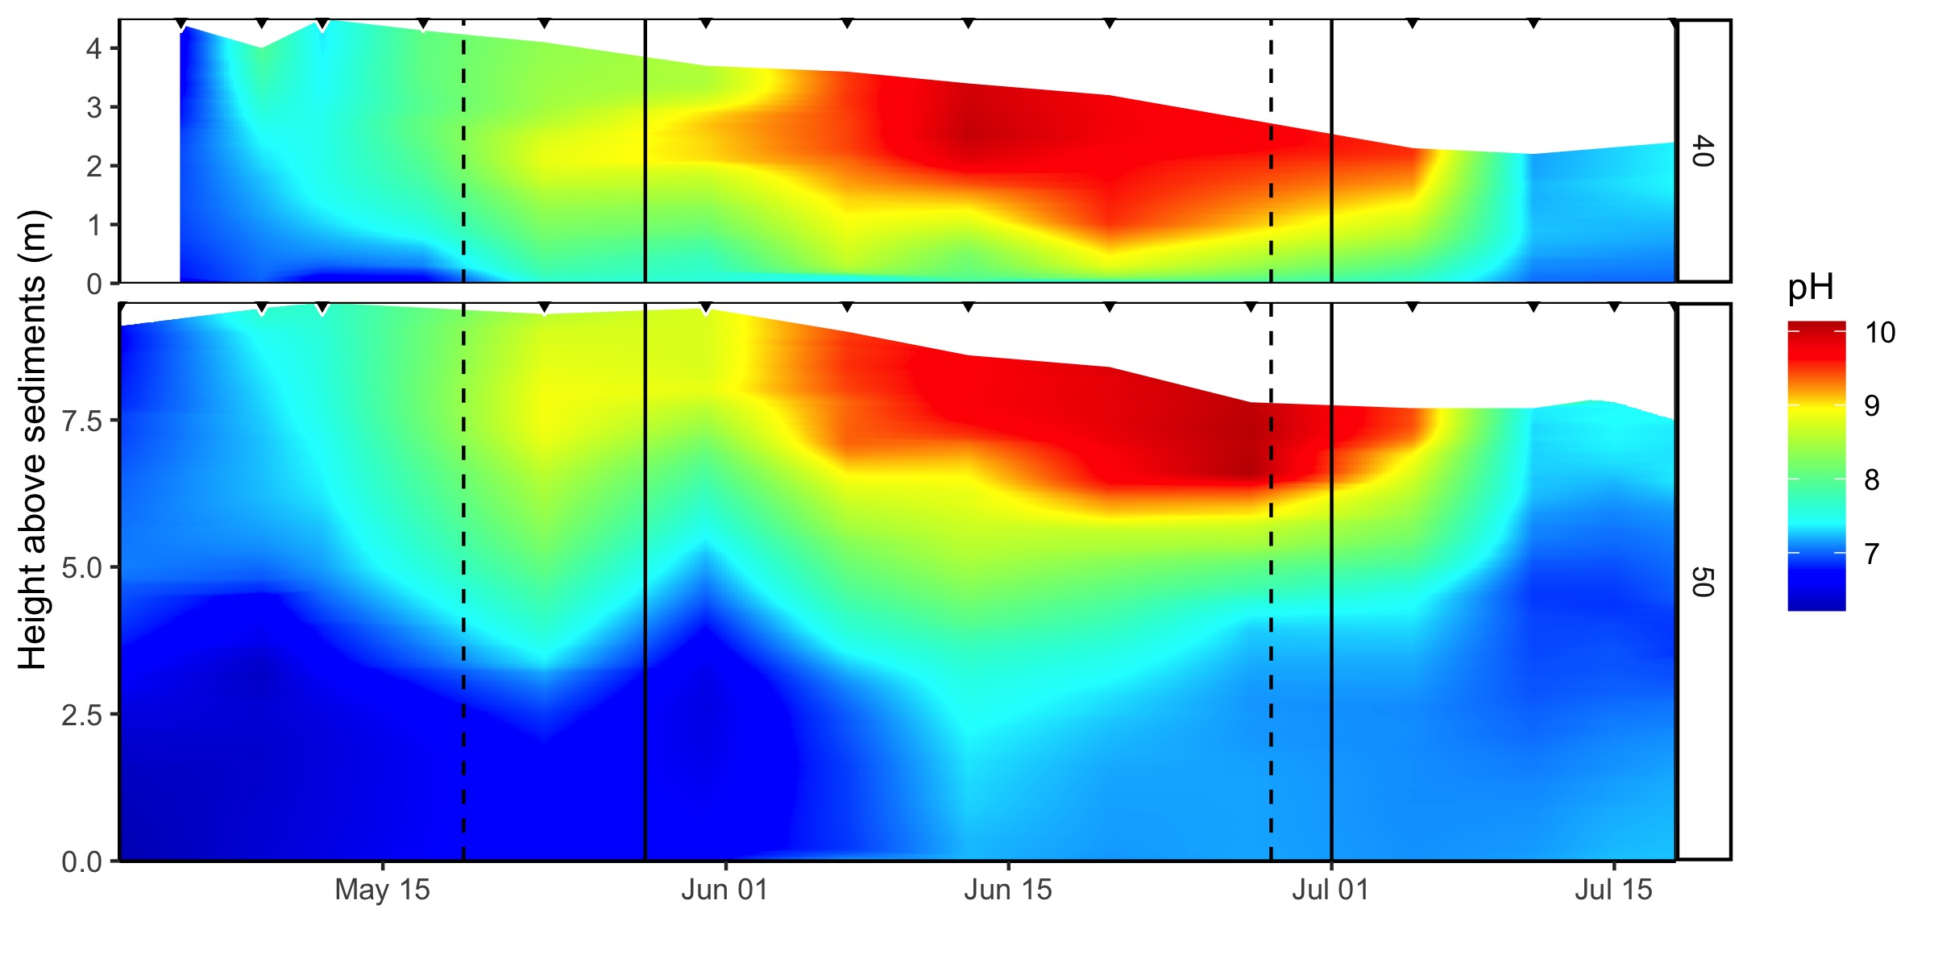
BVR Turbidity and pH
Increases in surface pH and turbidity during drawdown, potentially due to bank erosion

Slide 8
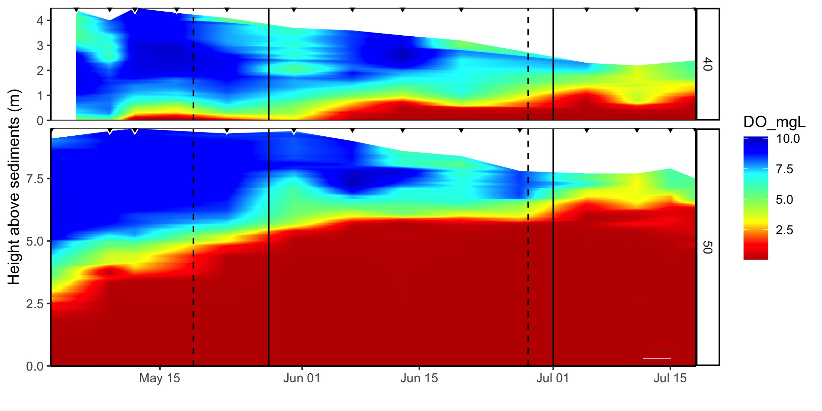
BVR DO
Loss of oxic surface water means that most of the water column is anoxic by the end of drawdown

Slide 9
Biological changes
Chl-a
Make a three panel figure with total fluorescence, chla from ctd, chla from exo
Phycocyanin
Fluora
Highlights: closer to the surface, more dominated by cyanos
Heather has ~monthly zoop samples that she could count

Slide 10
Emissions and export
Fe conc
Fe export
Note that these probably result from changes in the physical environment at the weir
GHG production
GHG emission

Slide 11
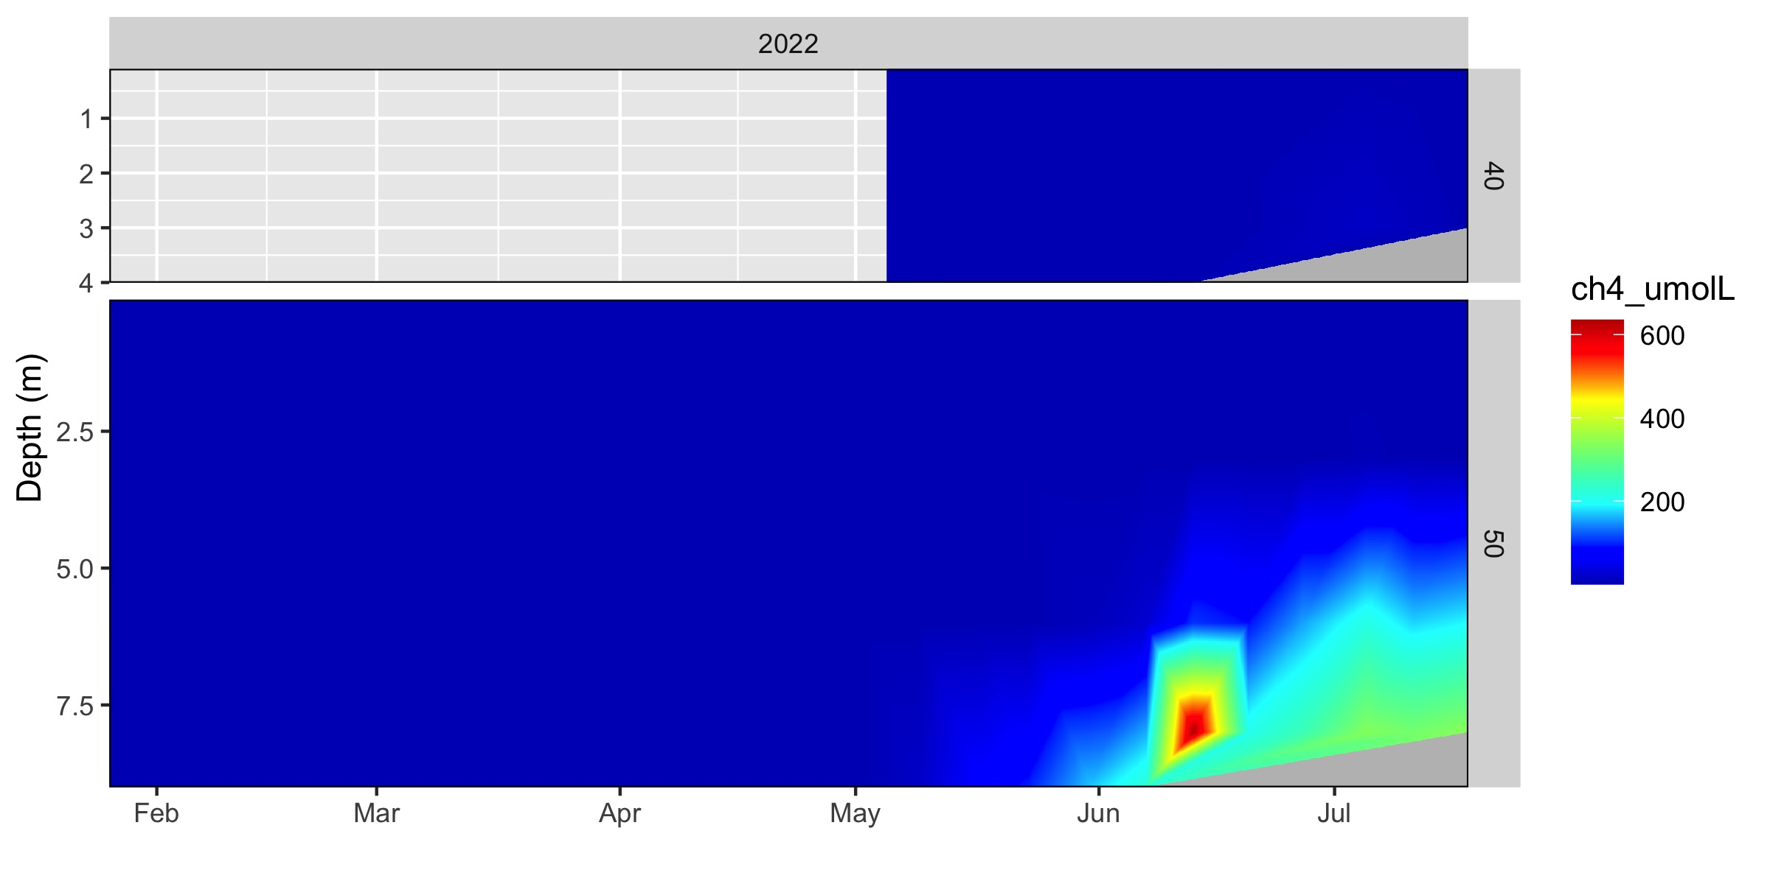
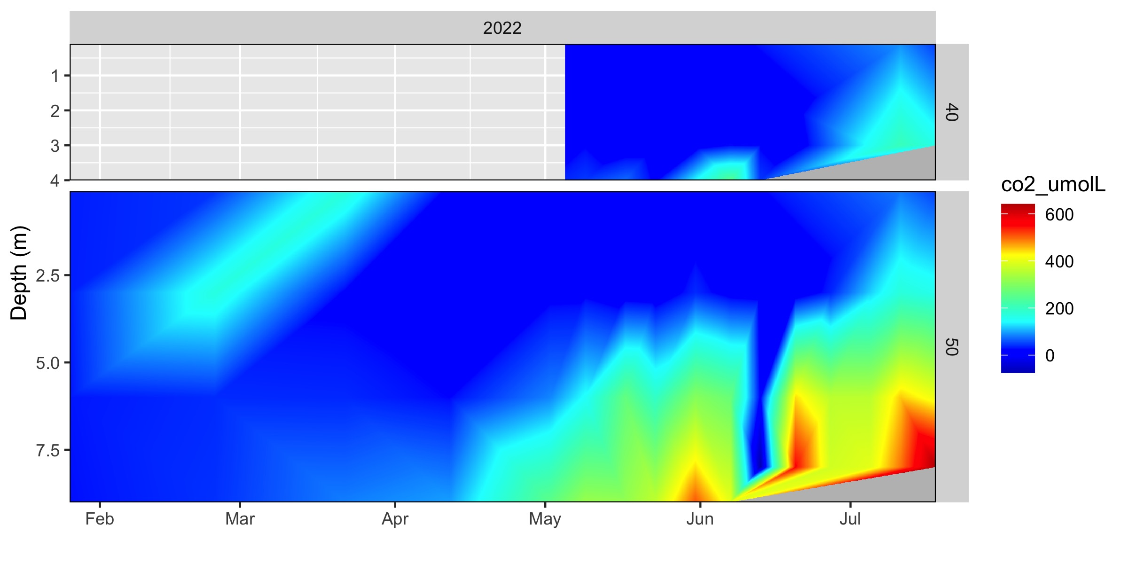
GHGs
Pulse of methane emission from site 50 in early June (aligned with the hypolimnetic spike)
Comparable emissions from site 40 (diffusing out without accumulating in the water column?)
CO2 emissions to the atmosphere are rising rapidly in July

Slide 12
Timing differences
Variables that respond immediately and return to baseline immediately
Phycocyanin
Metals at the weir
Variables with a sudden response to the change
Methane (dissolved and emissions)
Variables with a delayed response to both the start and the end
Turbidity
pH
Variables that did not return to baseline
Schmidt
Thermo depth

Slide 13
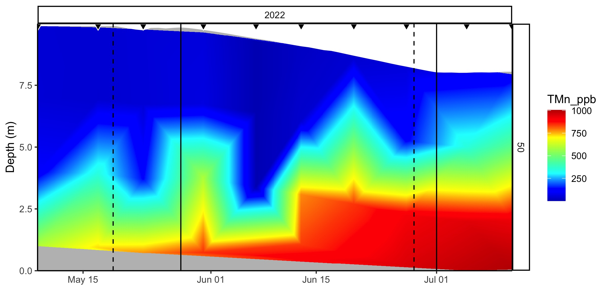
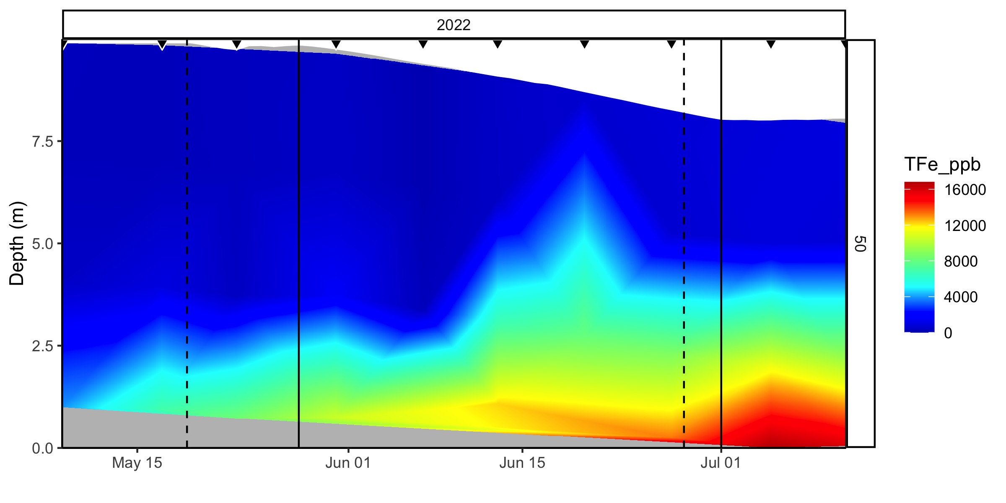
Metals

Slide 14
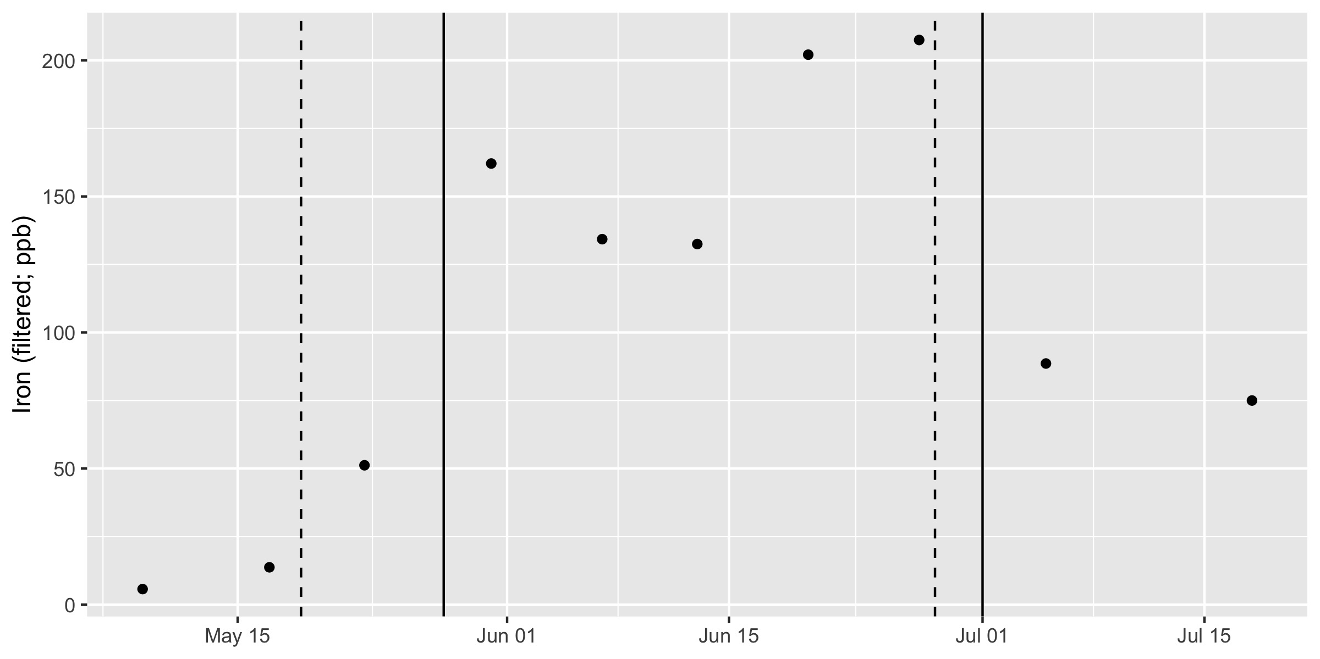
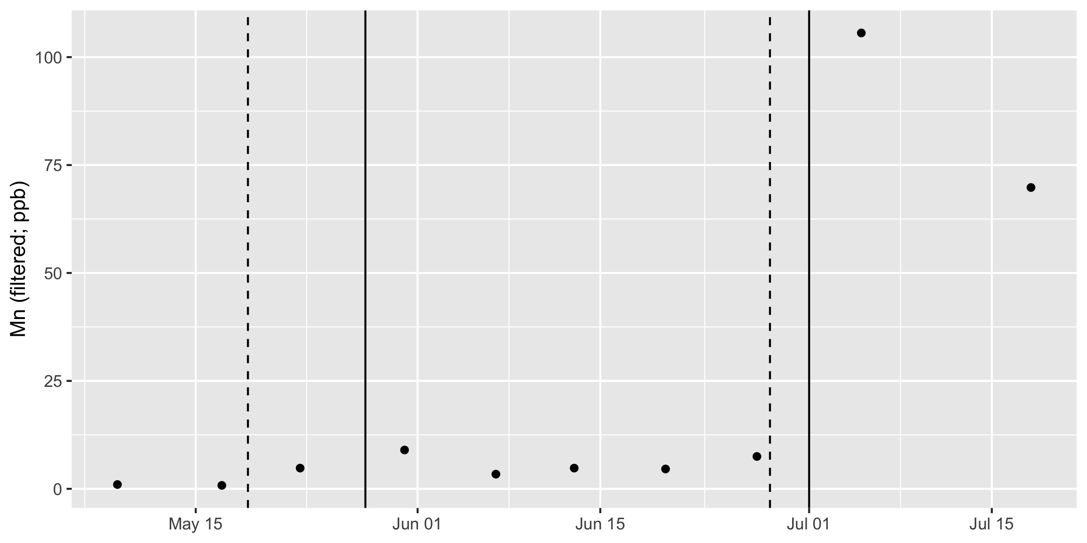
Increased export of Fe during drawdown and Mn after

Slide 15
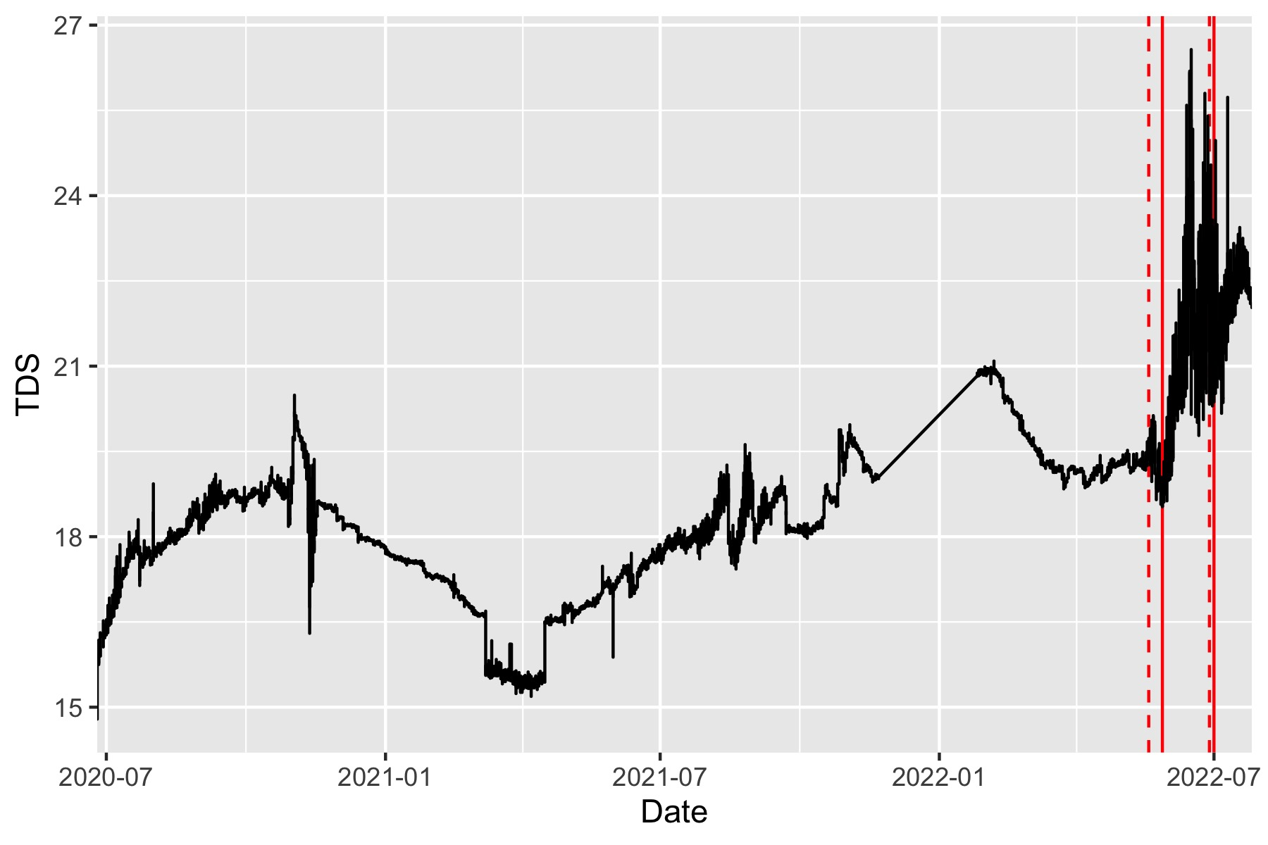
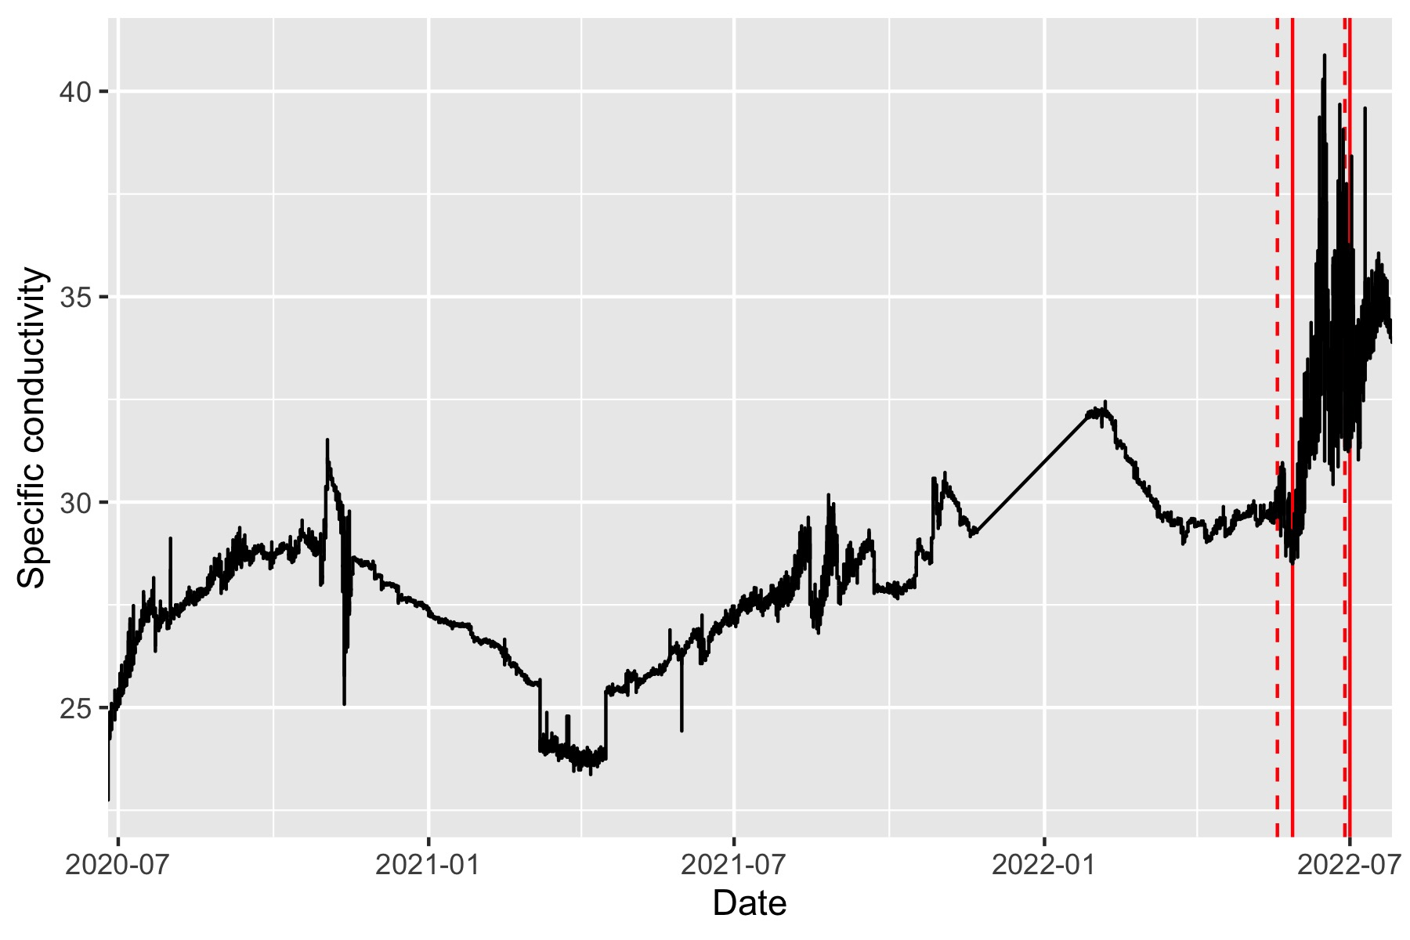
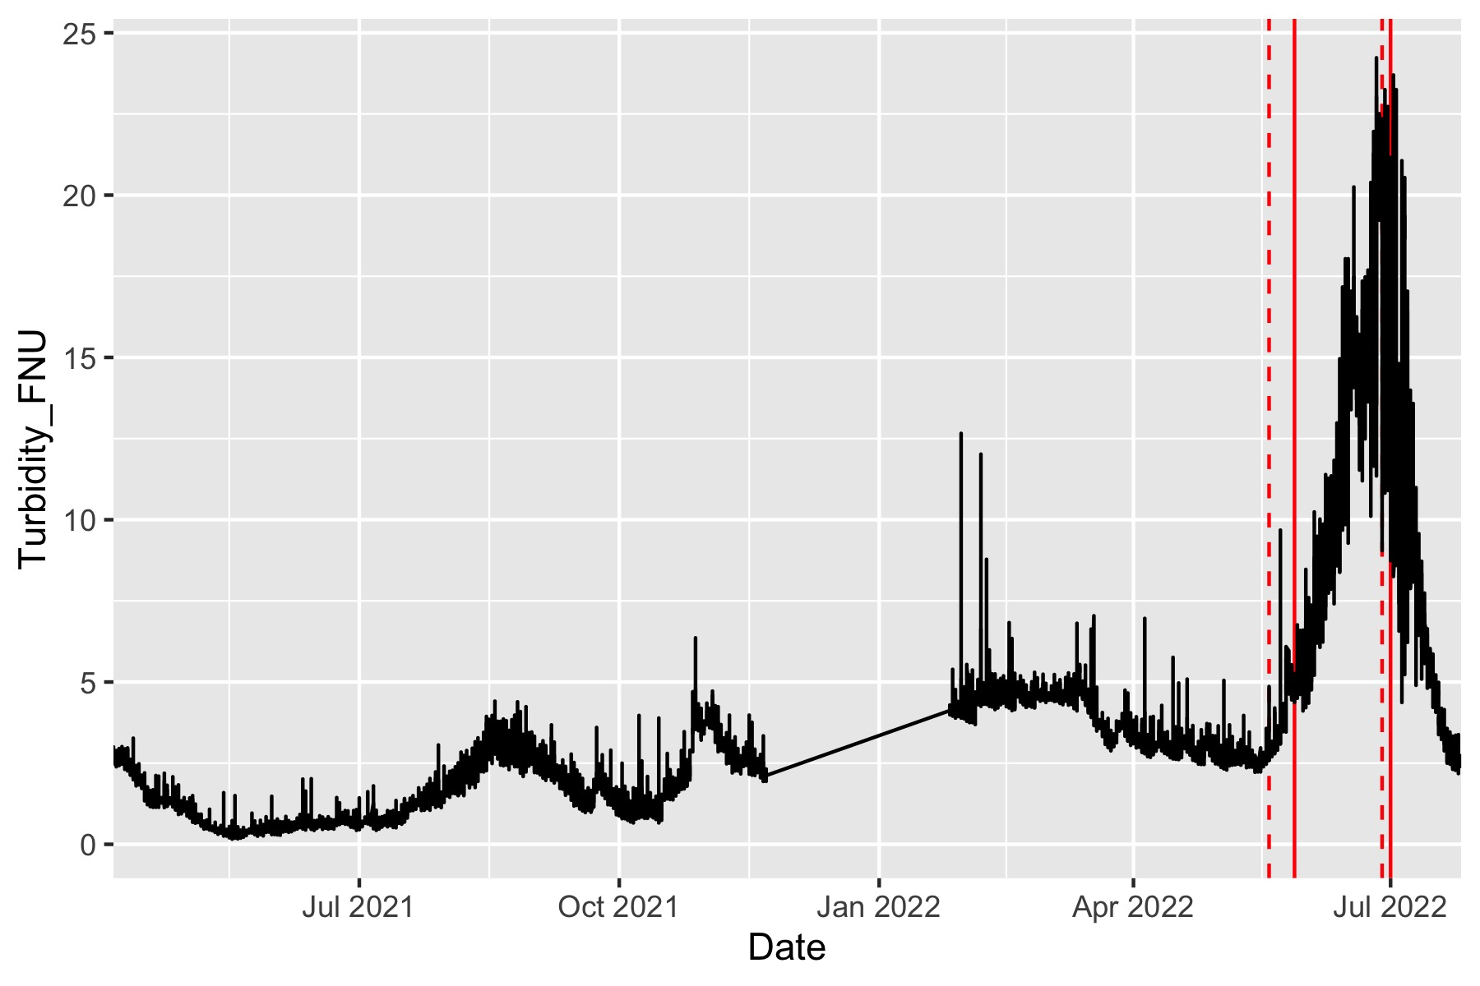
Cond, turb, TDS all increase

Slide 16
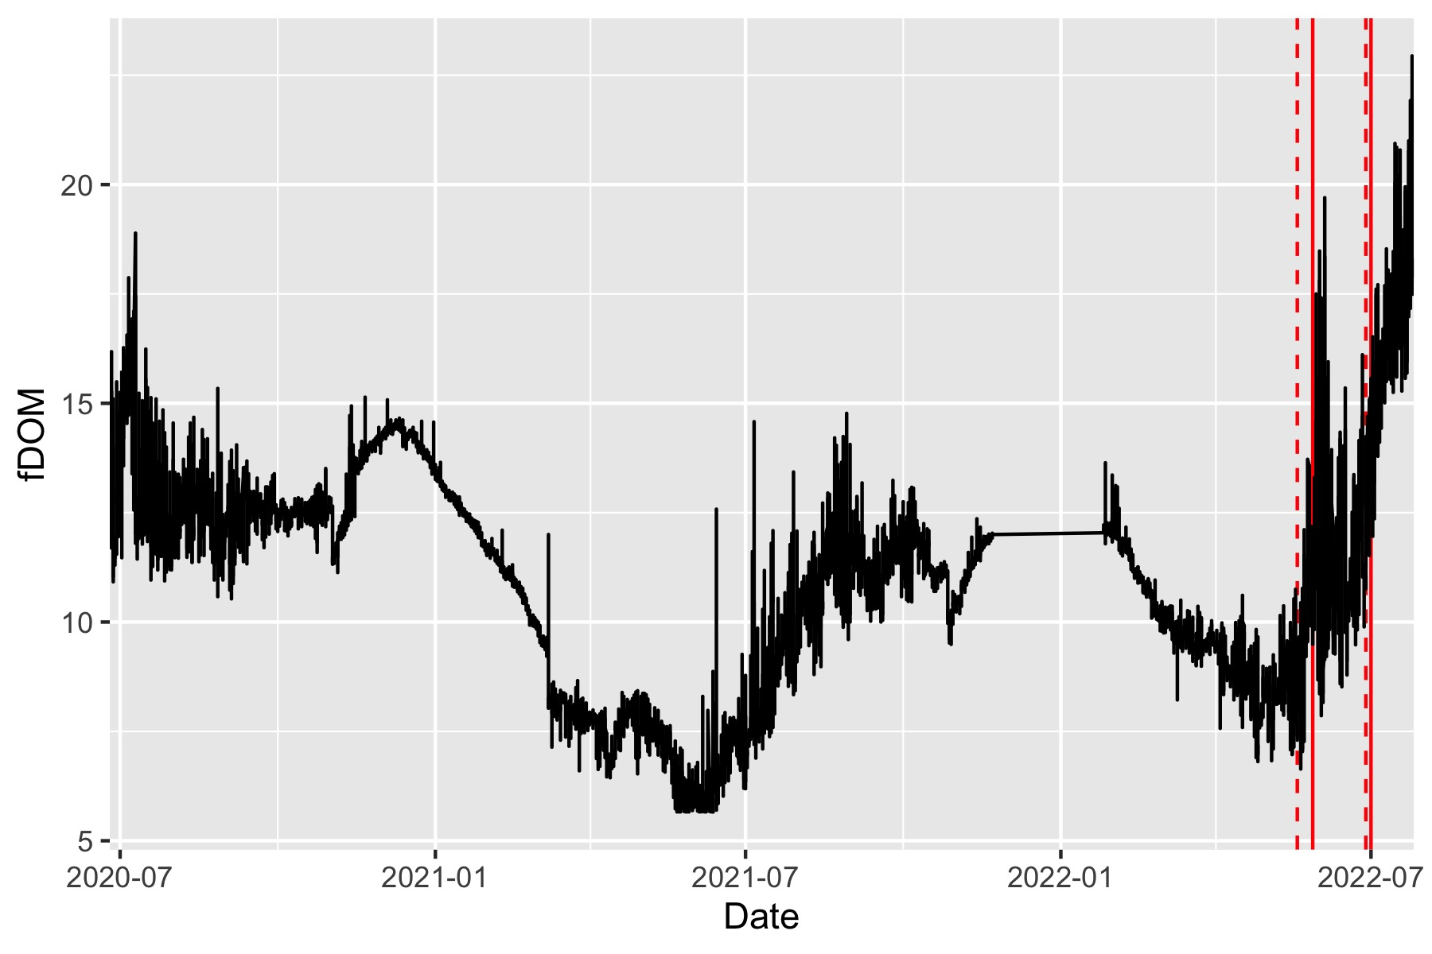
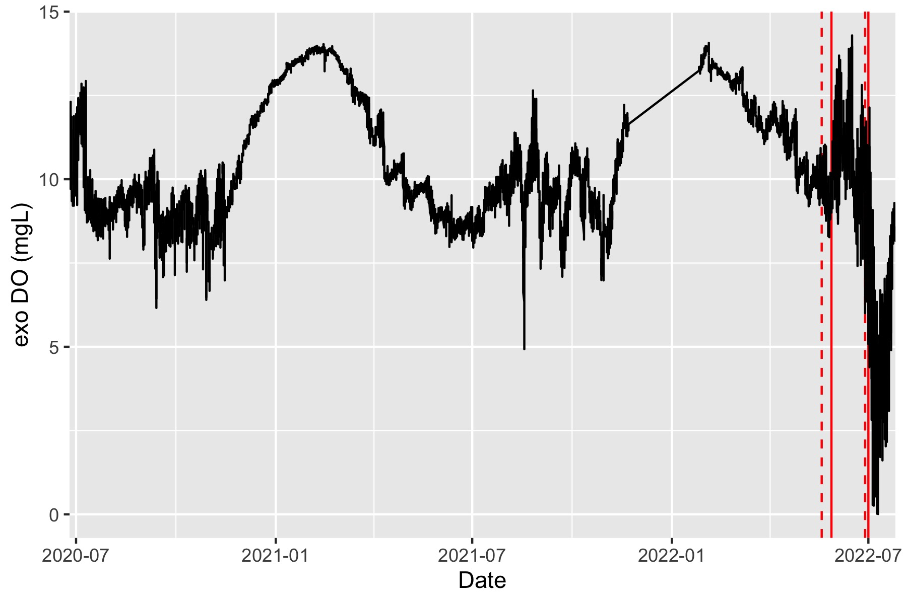
fDOM increased and DO decreased

